Slide 1
Exercise - NFC Cabinet Lock UID Cloning
Prep: Giving out the instructions, NFC Lock+Key and
a Flipper Zero to each group.
Instructions
NFC Cabinet Lock + Master Key
Flipper Zero

Slide 2
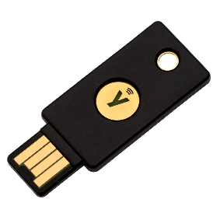
NFC Authentication Types
UID Authentication
  Insecure - relies on uniqueness of a NFC tag UID
Data based authentication
  Key is stored in the sector or page data of the NFC tag
Challenge–response authentication
  HMAC-SHA1 algorithm
  PAM Module - Pluggable Authentication Module
  Can be extremely difficult to clone/emulate

Slide 3
Exercise - NFC Password Protection & Brute Force
Prep: Giving out the instructions, NTAG215 tag to each student and a reader to each group.
Instructions
VM from thumb drive
ACR122U Reader
NTAG215 Tag (Round white tag)

Slide 4
Playing with NFC – Reading/Writing: (with ACR122U)
You could also use an PN532
Make sure you do the following for both ACR122U & PN532:
  Click on USB icon on top of the VM window 🡪 “USB & Bluetooth Settings”
  Make sure you have the following:
Notes:
Refs:
https://www.linux.org/threads/usb-serial-device-does-not-appear-as-dev-ttyusb.23105/
https://www.kali.org/docs/general-use/updating-kali/

Slide 5
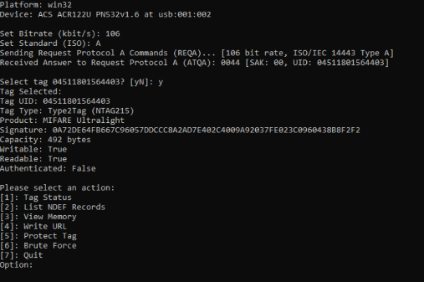
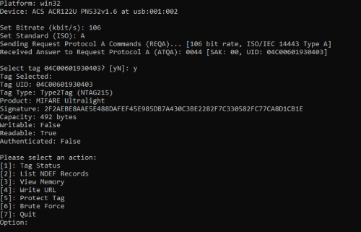
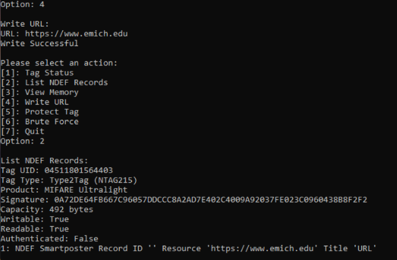
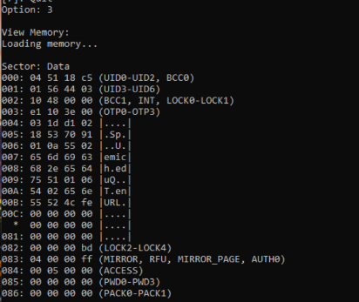

Slide 6
IoT Near Field Communication (NFC) Basics
Basics
  https://en.wikipedia.org/wiki/Near-field_communication
  http://nearfieldcommunication.org/
  Usually 13.56Mhz
  NFC builds on HF RFID
    Use cases differ between NFC and RFID
    Unauthenticated information sharing
    Contactless payment systems
    Used in mobile phones
  Bidirectional communications
  Actively powered
  Dynamic data storage
  NFC Data Exchange Format (NDEF)
    NDEF structured data
    Type Name Format (TNF)
  Android Beam
    “Tap to Beam”
  Google Wallet
    Host Card Emulation (HEC)
    Cloud access needed
  Apple Pay
    Cloud based
    Embedded secure element, stores EMV token
    Requires pre-authorization

Slide 7
IoT NFC Security
Security
  Same standard format across vendors
  Attacks usually associated with malformed data
  Targeted client devices
Vulnerabilities
  Android “Stagefright” malformed MP4 file
  Modifed URI data

Slide 8
IoT RFID/NFC Hardware Tools
Tools
  ACG LAHF Reader/Writer $300
  ACS ACR122 Reader/Writer $43
    Part of SEC617 class SWAT toolkit
  HID Proxcard II
    Door access control systems
    Wiegand Protocol
  Proxmark 3 RDV2/3 $220
    Linux or Windows software
  ProxBrute
    Attempts to elevate access privileges
  Tastic RF Thief < $400
    HID MaxiProx long-range reader
    Adafruit Feather Huzzah (ESP8266 SOC)
    Saves codes to memory
    Transmit over WiFi
  Linux RFIDIOt software
    Read/write cards

Slide 9
IoT NFC EMV
Europay, MasterCard, Visa (EMV) Cards
  ISO/IEC 14443 13.56Mhz
  Chipped credit cards
  RFID reads information similar to that of magnetic stripe
Security
  Card#, first and last name, expiration date, transaction counter
    Confidentiality exposed
  CVV2 not disclosed (Dynamic CVC)
Vulnerabilities
  Vulnerable to NFC Proxy attack
Tools
  EMV readers available
    VIVOPay
      Pwnpass application (Python script) reads out data
    Android EMV
      NFC SmartCard Info
    ACS ACR122U
      HF RFID and NFC
      Can emulate PICCs
      USB reader supported by Linux
  Linux: pwnpass, nfcproxy

Slide 10
IoT NFC MIFARE
MIFARE
  RFID chipset built into many products
Security
  Proprietary steam cipher crypto “CRYPTO1” for authentication
  Multiple flaws
  Weak 48 bit key length
    Default key often used
  Predictable nonce values
  Recover key by eavesdropping
  Recover key from PICC, takes time under 30 minutes
  With 1 key, attacker can recover all other keys on card
  Attacker can dump card and clone
Vulnerabilities
  Mix key and UID to authenticate
  UID unique to card
  Need writable card to clone it
Tools
  Linux: mfoc, mfcuk

